Slide 1
Intelligent Monitoring of Engineering Systems
Group 6: Intelligent Monitoring of the Production System

Slide 2
Group 6: Intelligent Monitoring of Engineering System
INTRODUCTION
METHODS
RESULTS & DISCUSSION
CONCLUSION & OUTLOOK

Slide 3
INTRODUCTION
Application of Intelligent Monitoring of Engineering System
Product/Machine Functionality
Operational Safety
Predictive Maintenance(wear monitoring)
Process Optimisation
Design Testing and Failure Analysis
Quality Control
Real Time Analysis required
Offline Analysis required

Slide 4

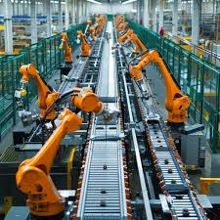
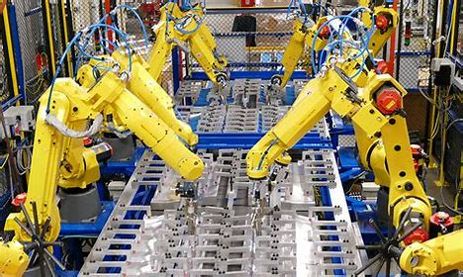
INTRODUCTION
Motivation
The motivation of the Project is to locate defects in a production line in real time so as to prevent any stoppages in the line as a result.

Slide 5
INTRODUCTION
Description
The tasks were to obtain acceleration to time data using a mobile phone as it moves across the production line while our phones were located at defined positions along the production line and use the data obtained to figure out the location of the defects by training a ML or deep learning model to do so.
Division Of Responsibilities
Data Collection
Data Pre-processing
Abhishek Nain, Sumit Deshmukh
Vedant Chavan, Sumit Deshmukh
Feature selection
Neelabh Bhadauria, Abhishek Nain
Computational model
Abhishek Nain, Vedant Chavan
Presentation and Report
Neelabh Bhadauria, Abhishek Nain

Slide 6
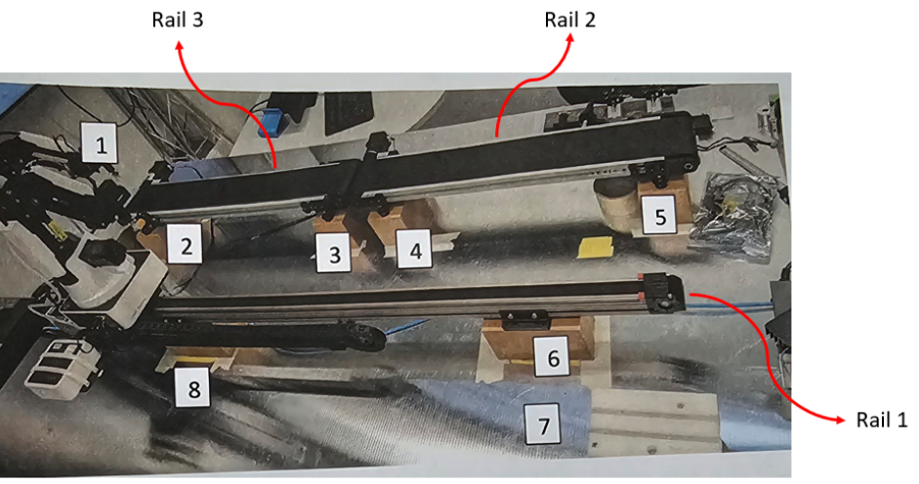
EXPERIMENT
Data Collection
Record data from the assembly line by utilizing our cell phones’ sensors while an item (also recording the acceleration data) progress along the production line.
The Data is collected as Excel files which contain Time, Linear Accelerations with respect to X, Y and Z axes along with Absolute Acceleration.
Assembly line setup
Image Source : IMES course documents

Slide 7
METHODOLOGY
Phyphox
Recording the linear
acceleration w.r.t time
Data preprocessing: Signal
filtering and FFT
Experimentation
Testing and cross
validation
Computational
model
Feature extraction
Python
Flowchart depicting whole methodology of our project

Slide 8
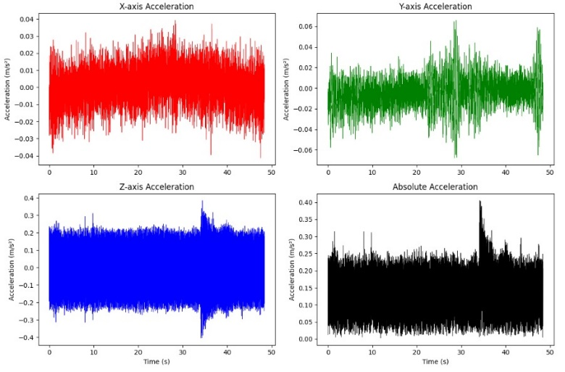
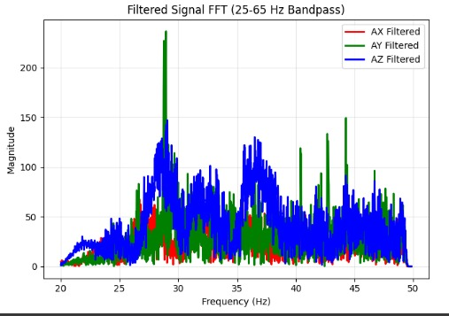
SIGNAL PRE-PROCESSING
After collecting the data, we applied filtering techniques to eliminate noise from the dataset by using a band-pass filter on the time series data. The frequency range was kept from 25 to 65 Hz, as in training data the frequency defects fall within that range.
Next, an FFT analysis was performed on the filtered data to visualize the frequency components and confirm them against the provided dataset for visual confirmation of the frequency (corresponding to the defect frequency) for further feature extraction.
Image Source : Python
Example of filtered signal with FFT

Slide 9
DATASET
Creation of a Data Frame
Data Frame creation to train our ML/DL model.
Raw Metadata Files
Clean & Assign IDs
Combine Metadata
Save cleaned Metadata
Raw Sensor Data Files
Load Preprocess Signals
Extra Features (FFT, stats)
Join Features with Metadata
Save Features Data-Frame
Final Data Frame

Slide 10
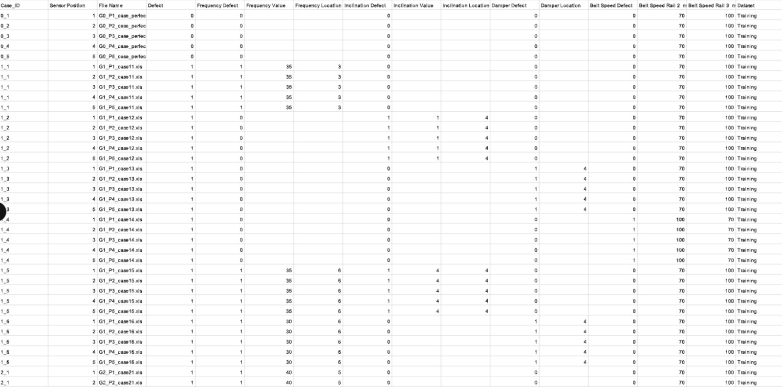
Meta Data
A dictionary created to identify defects type and location as per group, case and sensor.
Purpose: To classify whether a defect is present in a given case — using binary labels (0 for no defect, 1 for defect).
Metadata file snippet
Image Source : metadata.csv

Slide 11
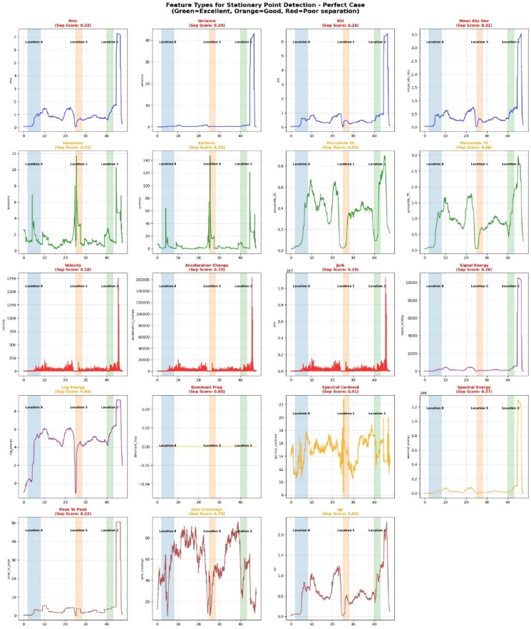
Mapping timestamps with section
25 percentile acceleration
Various features were extracted from the raw acceleration data, such as spectral energy, Percentile_25, and Percentile_75. These features revealed distinct differences between the various stages of the test.
Among them, Percentile_25 achieved the highest separation score, effectively highlighting the sensor's transitions across different stages.
If a defect is present at a specific location in a given case, all timestamps in the acceleration data corresponding to that section are labeled as 1; otherwise, they are labeled as 0.

Slide 12
FEATURE SELECTION
Base features for Frequency defect model (using ML):
FFT and frequency domain features. Eg – peak frequency, magnitude, mean.
2) Time domain features (mean, std, var, etc), statistical features overall and section wise.
Base features for Damper and inclination model (using DL) :
1) Filtered Ax, Ay, Az, timestamp 2) Statistical (rolling means, standard dev), etc

Slide 13
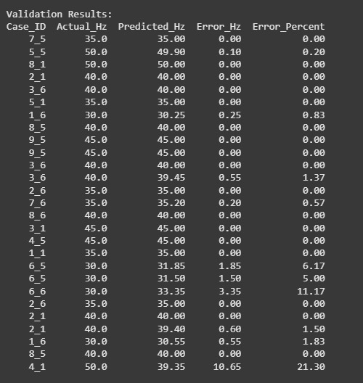
COMPUTATIONAL MODEL
Random Forest Classifier and frequency value prediction
We initially attempted to identify cases with frequency defects using a random forest classifier. Afterward, for those identified cases, we estimated the magnitude of the frequency defect with a regression model.
We used another model for the location prediction for the frequency defect.
Developed a machine learning model to detect and localize frequency-related defects in machine sections using section-wise features from real measurement data.
Addressed high imbalance using class weighting and SMOTE oversampling, ensuring robust performance across both defective and normal sections.
For location prediction model we achieved the accuracy of 83%
Frequency value regression

Slide 14
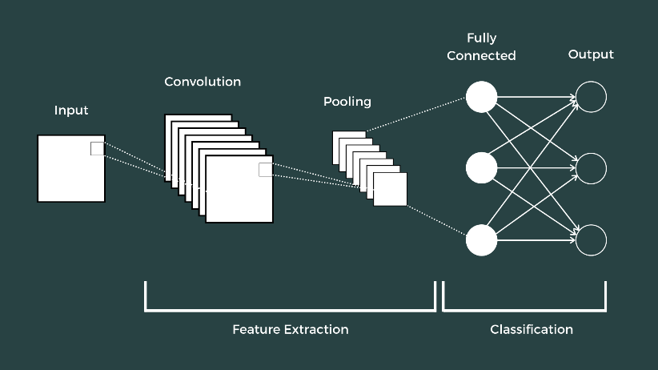
COMPUTATIONAL MODEL
Selection of Computational Model
Principally, we made use of Fast Fourier Transform algorithm for Signal testing.
Since we had time-series data we short-listed LSTM , CNN and Fully connected feed-forward.
But finally went ahead with : CNN
Our primary CNN model had the highest recorded accuracy
Convolutional Neural Network

Slide 15
MODEL INFORMATION
Convolutional Neural Network
Working of our CNN Model
Defining input and output features: X (features) and Y (labels)
Giving input and scaling X
Reshaping X for CNN
Defining CNN Model:
1. Defining inputs
2. Adding Convolutional, pooling and flattening layers
3. Defining multiple output layers
Compiling model with loss function and metrics
Training the model
Predicting on testing data
Converting categorical data to binary matrix for CNN
Splitting dataset(Updated Data Frame 2.0) into training and testing
Decoding and displaying results

Slide 16
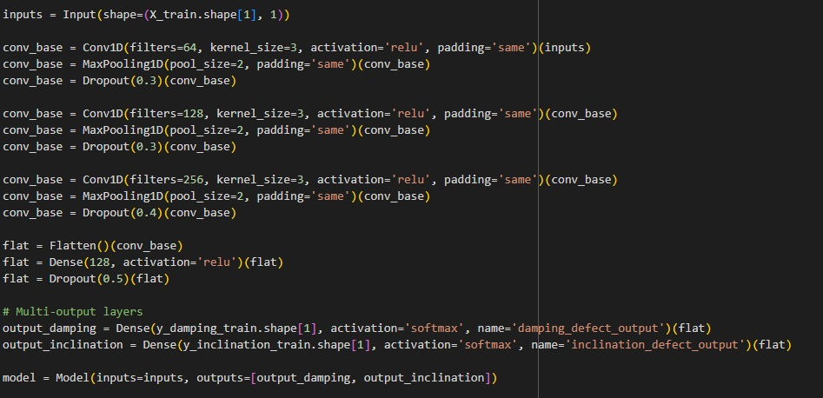
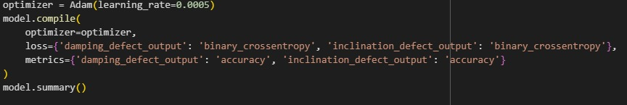
MODEL INFORMATION
Convolutional Neural Network
Input signal Assignment:
Time, Acc (in X,Y,Z) and Section
the number and signal assignment of input
Training : (213320 , 5 , 1)
Model Structure:
Fully connected Conv1D, two hidden layers and ReLU activation.
Hyper-parameter and Model tuning over learning rate, loss function and input/output.
Model Creation
Output signal Assignment:
Model output generates categorical values for Damping and Inclination Location
the number and signal assignment of output
Training : (213320 , 2)
1D CNN Model Compilation
Image Source : Python
14
Notes:
Fully Connected Conv1D: This refers to a one-dimensional convolutional layer fully connected to the subsequent layers, allowing the model to capture temporal dependencies in the data.
Two Hidden Layers: These layers help the model learn complex patterns by transforming the input data into a higher-level representation.
ReLU Activation: The Rectified Linear Unit (ReLU) is used as the activation function, introducing non-linearity to the model and helping it learn intricate patterns more effectively.
We adjusted various hyper-parameters such as learning rate and loss function to optimize the model’s performance.

Slide 17
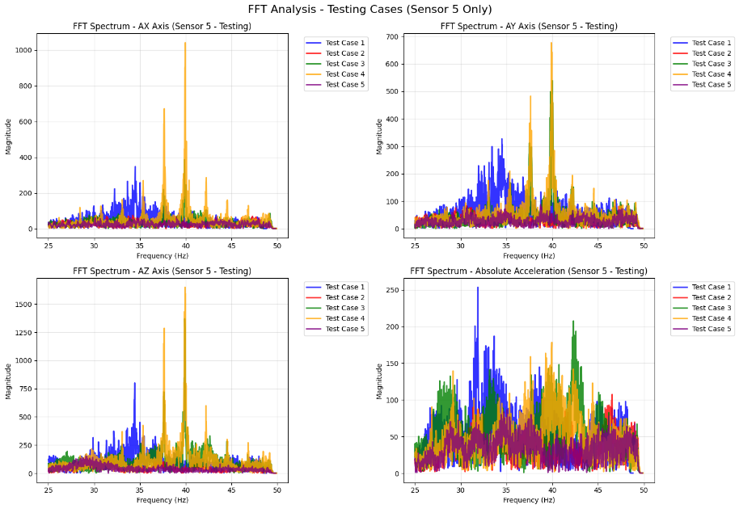
RESULTS & DISCUSSION
Frequency Result from FFT
For the testing data received, after running an FFT on the same, we got the frequency peaks for cases 1, 3 and 4 with 35Hz, 40Hz, 40Hz.
For cases 2 and 5, we got no peaks for frequency defect.
Image 13: FFTs on Testing Data
Image Source : Python
15
Notes:
As mentioned before, owing to our first few iterations, we chose to run the CNN model to find out only the Damping and Inclination Location. For Frequency, we visually observed the peaks on the FFT plots to identify the frequency associated with the test case. For test cases 1, 3 and 5 that we were given, we identified a frequency of 65Hz whereas in cases 2 and 4, we identified no such peaks.

Slide 18
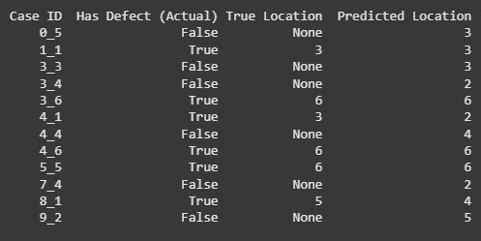
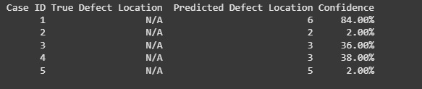
RESULTS & DISCUSSION
Frequency Location Prediction using Python
For the testing data received, after running an FFT on Python, we got the frequency locations at location 6 for test cases 1, and at location 3 for both case 3 & 4.
FFT on Group –Test Data
Image Source : Python
16
Notes:
Here, we present the frequency location predictions made using Python. The testing data, after FFT analysis, indicated frequency locations at position 5 for test cases 1, 3, and 5. The visual representation on the slide aids in understanding how our model predicts frequency locations accurately based on the input data

Slide 19
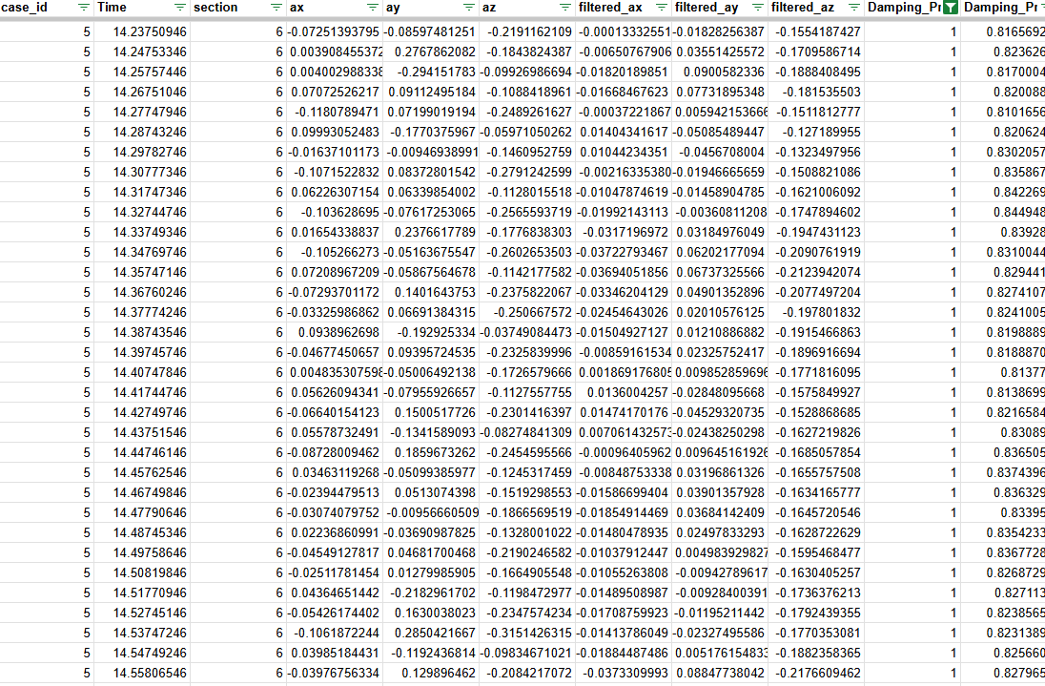
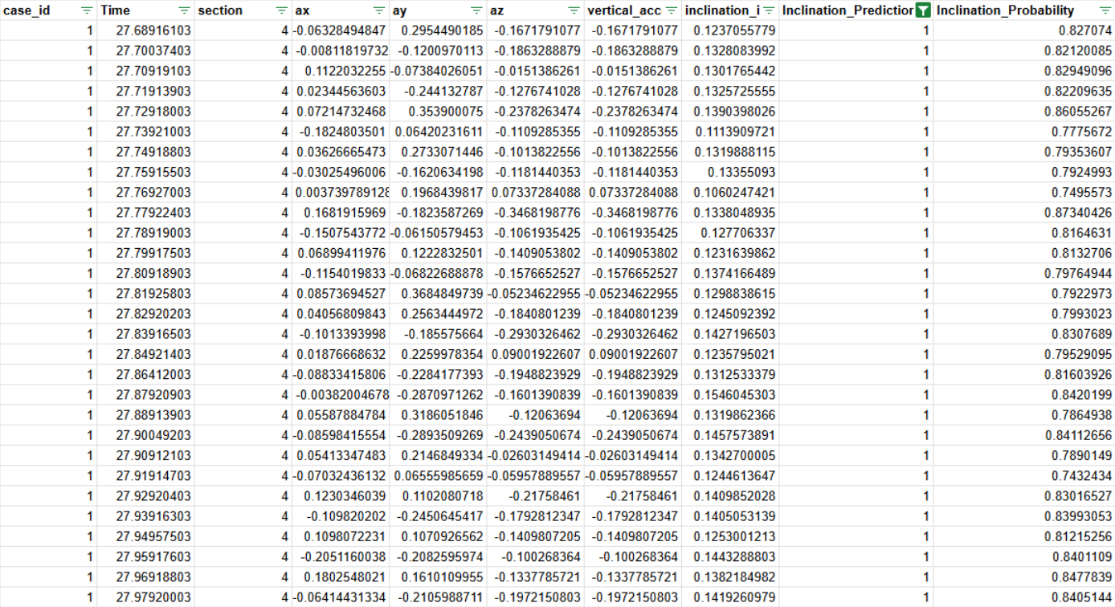
RESULTS & DISCUSSION
Prediction of Damping and Inclination
Generated CSV files with Damping and Inclination predictions.
The number of 1s predicted for Damping and Inclination Location corresponds to the predicted location. Shown below an example from Testing
Predicted Damping Defect
Predicted Inclination Defect
Image Source : Prediction output csv
17
Notes:
Finally, we discuss the CSV files generated with damping and inclination predictions. The number of 1s predicted corresponds to the actual damping and inclination locations with respect to the serial numbers which correlate to the time stamps which in turn are associated with a specific location. An example from test case 5 is shown, demonstrating our model’s prediction accuracy. This slide highlights the practical application and validation of our model predictions using real data

Slide 20
RESULTS & DISCUSSION
Generalization Ability
Conv1D CNN :
Generalization ability :
Did it work? Yes, but. Further fine tuning is required to improve recall for the defective timestamps.
Test Case | Frequency | Frequency Location | Inclination Yes/No | Damper Yes/No
1 | 35Hz | 6 | Yes at 4 | Yes at 5
2 | 0 | - | - | -
3 | 40Hz | 3 | - | -
4 | 40Hz | 3 | Yes at 4 | -
5 | 0 | - | - | Yes at 6
Table 1 : 1D CNN Model Predictions
19

Slide 21
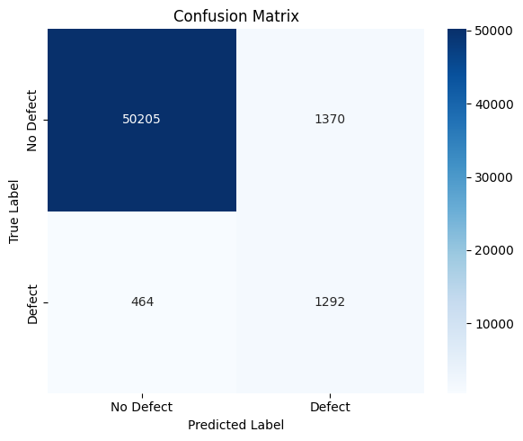
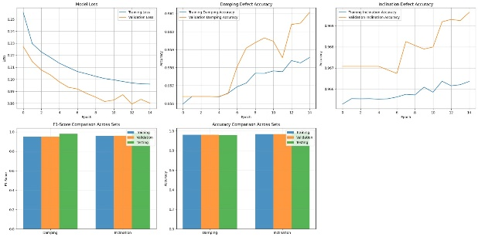
RESULTS & DISCUSSION
Cross Validation
Validation Input Assignment:
the number and signal assignment of input
Training : (53331 , 4 + x* , 1)
Validation Output Assignment:
the number and signal assignment of input
Training : (53331 , 4 + x*)
Validation Metrics:
Damping Defect :
Accuracy : 93.8%
F1 Score : 0.94
Inclination Defect :
Accuracy : 96.9%
F1 Score : 0.96
Confusion Matrix Inclination Location
Loss vs Epoch
Note : While the recall for ‘1’ for damping was 0.5825 for damping and 0.73 for inclination.
Image Source : Python * - Additional features based on the model
18

